Slide 1
Application Setup

Slide 2
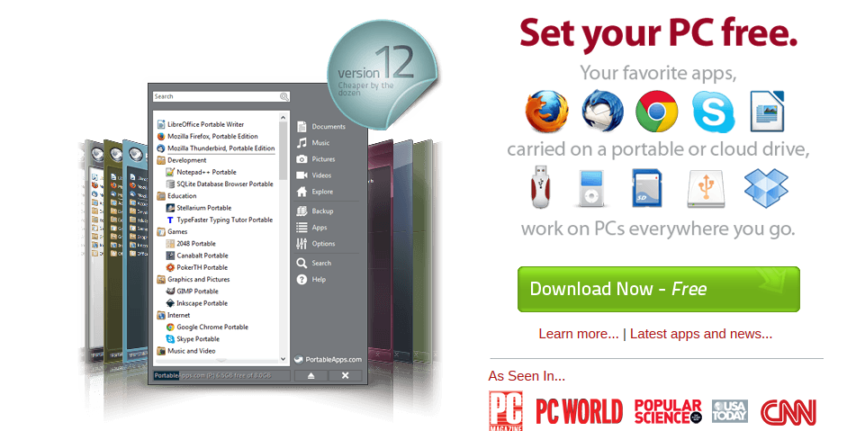
Portable Apps are “stor ‘n go” applications for Windows and Mac that can be installed on flash memory (thumb drive) that allow students to carry their applications with them wherever they go – home – school – work!
Go to http://portableapps.com/
And did I mention free?

Slide 3
Click on ‘Download on the Menu Bar
Download the latest version of PortableApps.com Platform (this screenshot shows Version 12.0.5)
If a Security Warning displays, click the yellow bar and select Download File

Slide 4
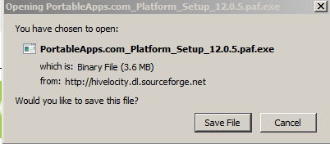
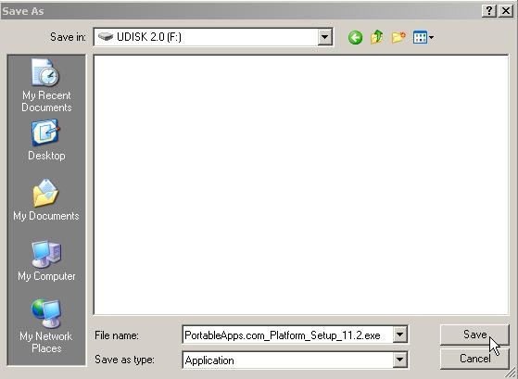
At the File Download Security Warning, select the Save File button.
At the Save As dialog box, navigate the USB drive (the drive letter may be different) and click the Save button

Slide 5
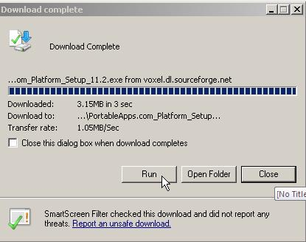
At the Download Complete dialog box, click the Run button
If you get an additional Security Warning, click the Run button again

Slide 6
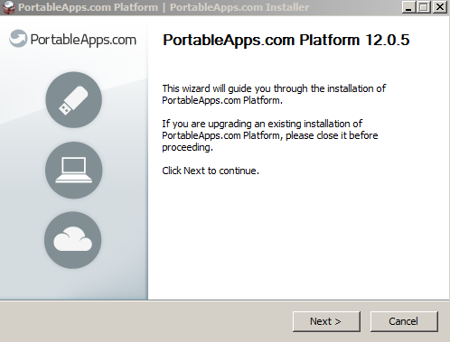
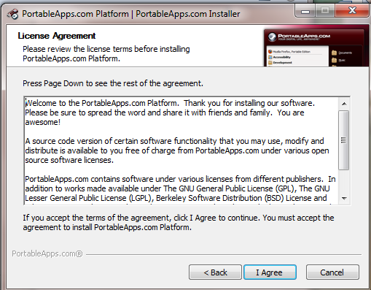
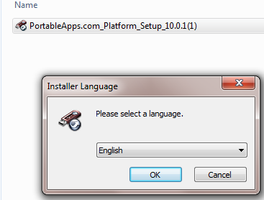
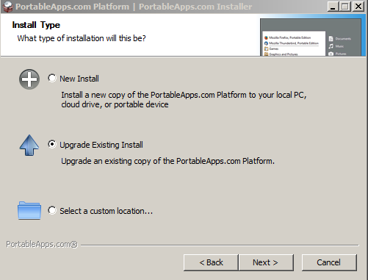
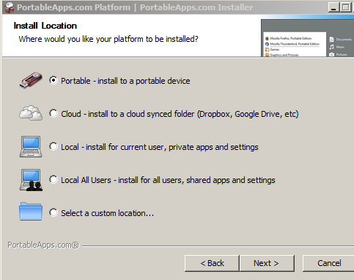
Select English and click OK. Click the ‘Next> button’, and then click the ‘I agree’ button.
Select New Install and click Next>
At Install Location, select Portable – install to a portable device and select Next>

Slide 7
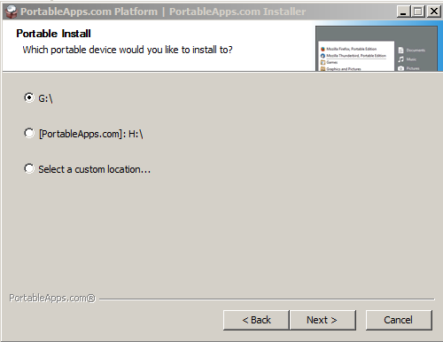
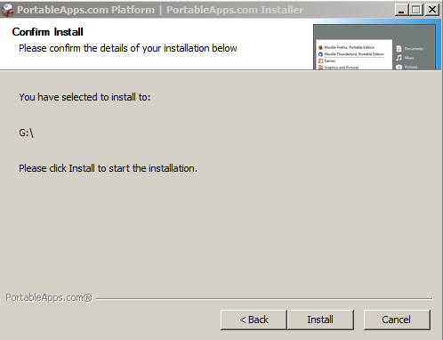
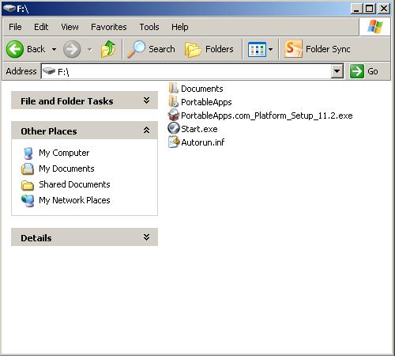
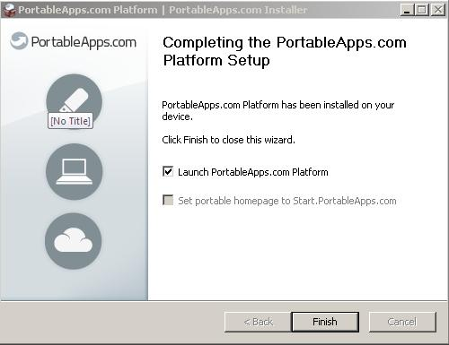
At the Portable Install, select the Drive letter of your Flash Drive and press Next>
Click Install
When the application has finished installing, click the Finish button.
If for some reason the program gets closed out, simply open your flash drive and double click ‘Start.exe’.

Slide 8
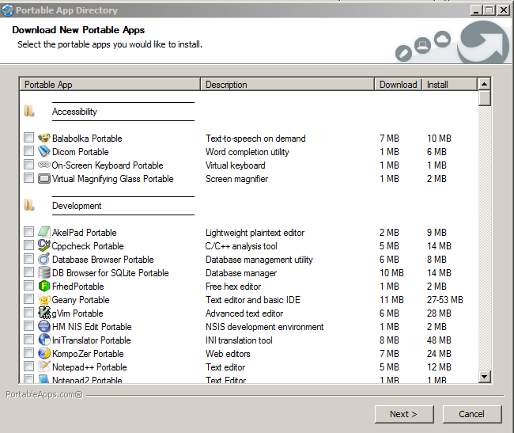
Portable apps will search for applications automatically and present a screen for you to Download New Portable Applications.
Click the Cancel button.

Slide 9
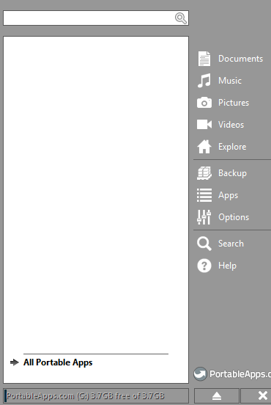
When Portable Apps is running, you will see a small icon on your taskbar.
Click the icon to display the Portable Apps Menu.
If for some reason the program gets closed out. Simply open your flash drive and double click ‘Start.exe’

Slide 10
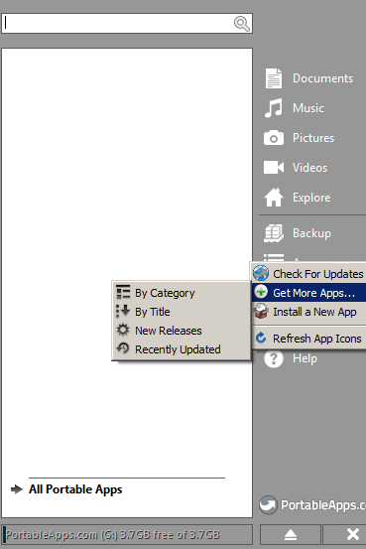
Now you are ready to install your Apps!
Click on Apps and select ‘+ Get More Apps’ | By Category.

Slide 11
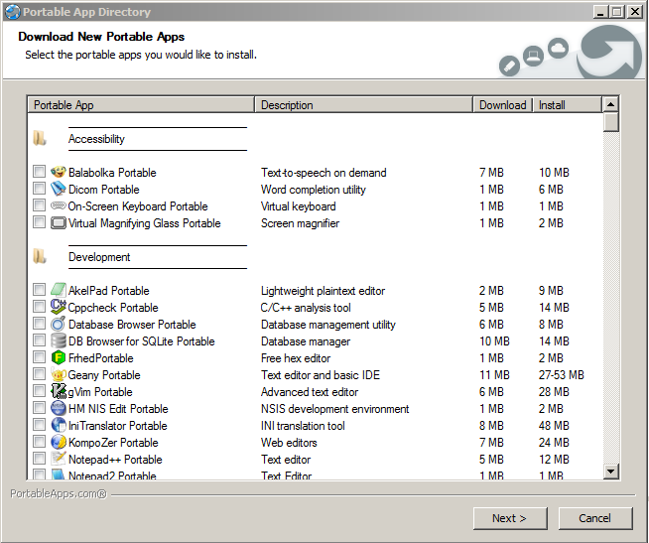
This is your ‘Apps Directory’.
We’re going to install two applications – GIMP and WinSCP

Slide 12
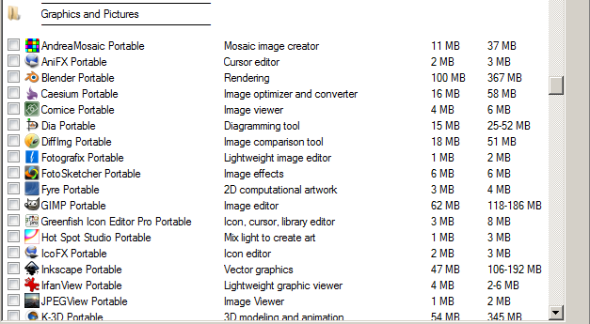
The first app we want is GIMP.
GIMP is a GNU Image Manipulation Program or as I like to think of it “a poor man’s version of Photoshop”. It does almost everything Photoshop does, but without the price tag.
The second application in WinSCP under Internet
Click Next> and the two applications will download and install for you.
You may want to get a cup of coffee – this may take awhile!
For more information on GIMP go to http://portableapps.com/apps/graphics_pictures/gimp_portable

Slide 13
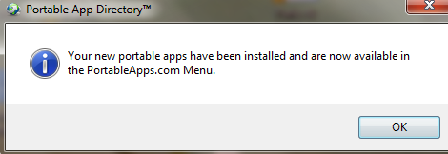
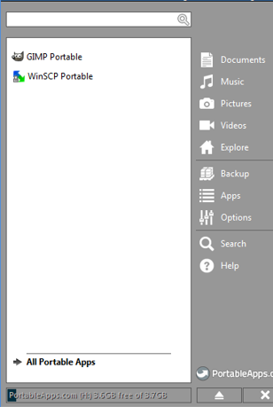
Success! Your apps are available, click OK.

Slide 14
Click the “X” on the Portable Apps Menu to close
The next tutorial will show you how to create a profile and upload files to the server using Notepad++.

